Slide 1
Amyotrophic Lateral Sclerosis (ALS)
Introduction to ALS,
A brief review of data retrieval for ALS phenotypes database from biological databases,
ER diagram,
Example query
A brief discussion

Slide 2
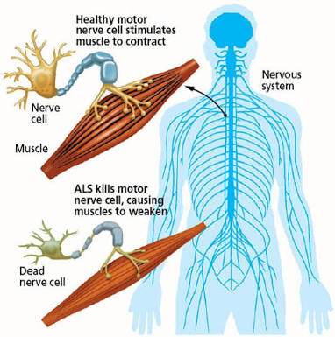
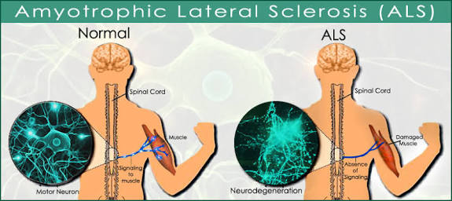
Amyotrophic Lateral Sclerosis (ALS) is a name of a group of diseases which mainly affect the neurons that are responsible for voluntary muscle movement

Slide 3
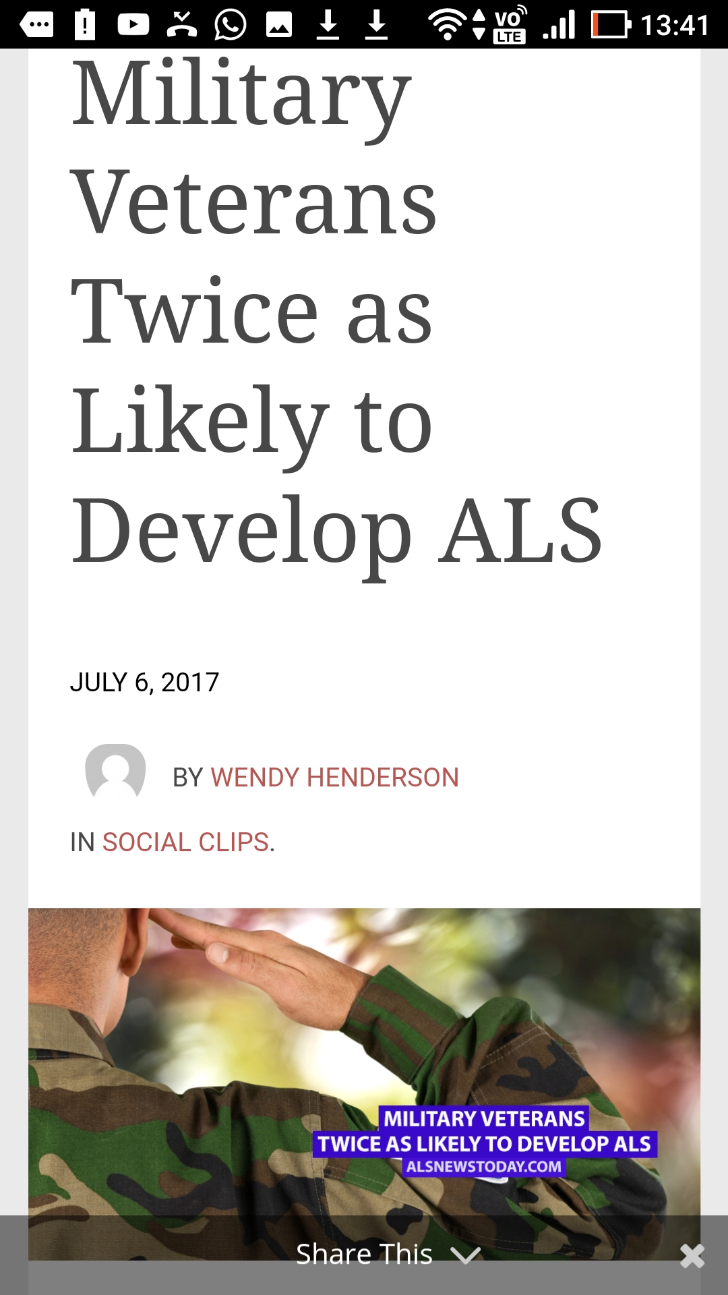
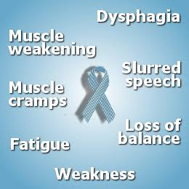

Slide 4
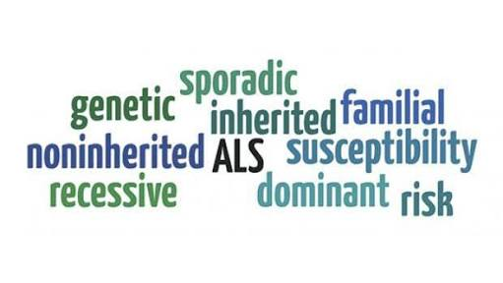

Slide 5
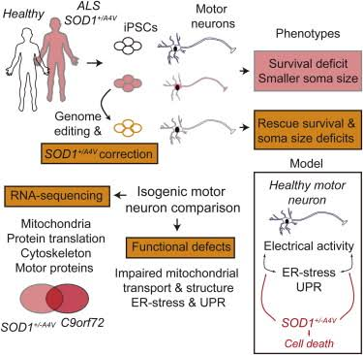
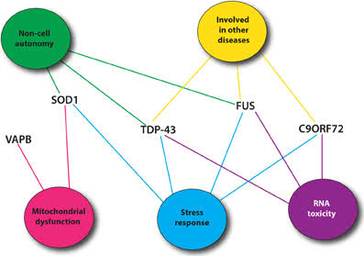

Slide 6
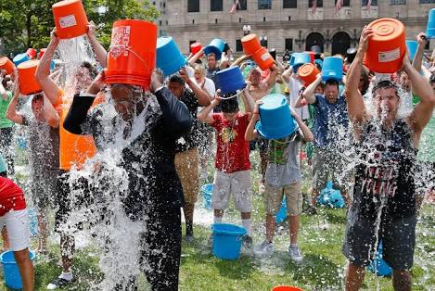


Slide 7

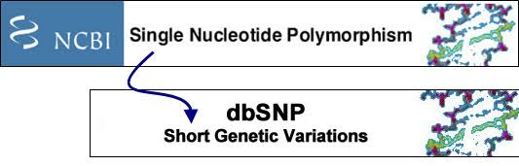

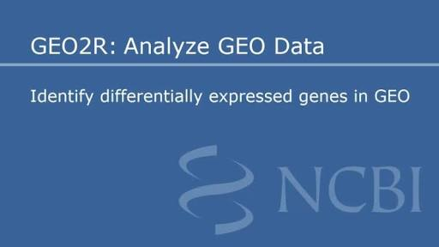

There are 6 tables in the db, and their data come from the current biological databases.

Slide 8
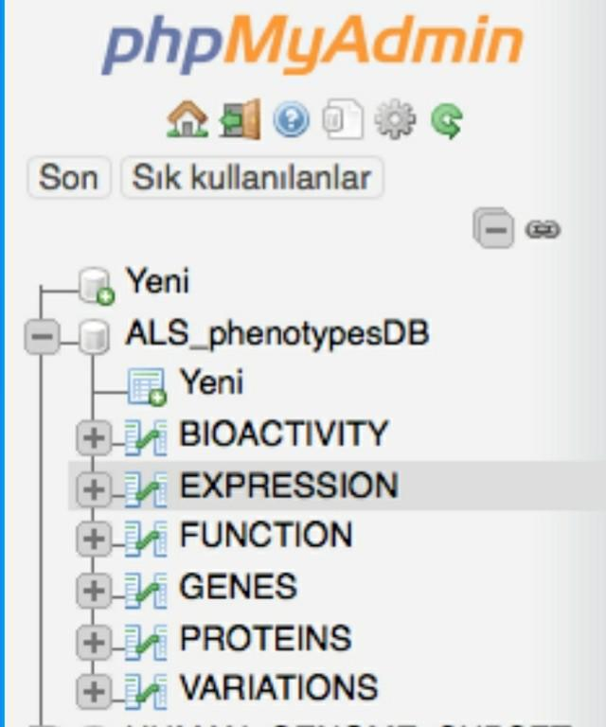

Slide 9
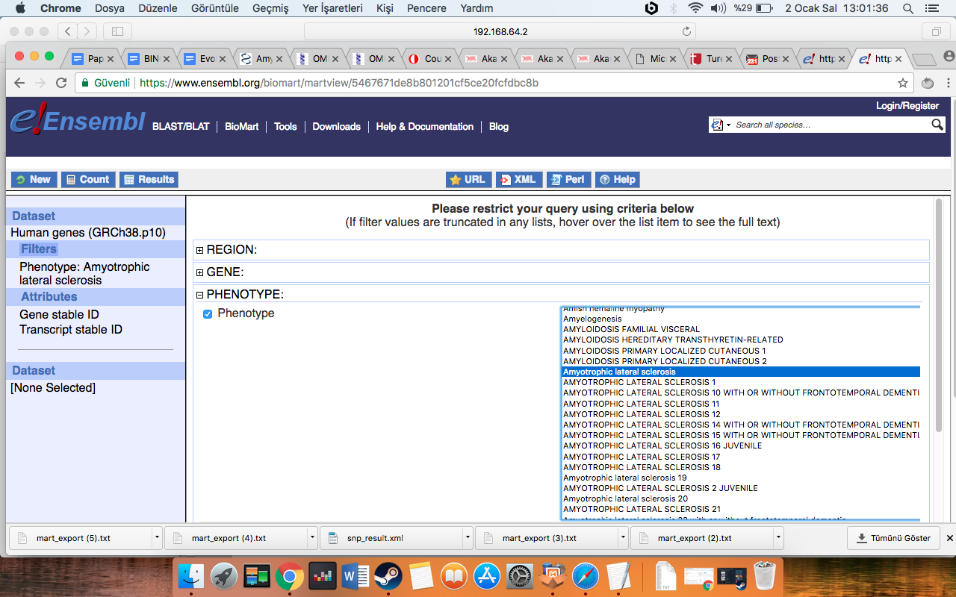

Slide 10
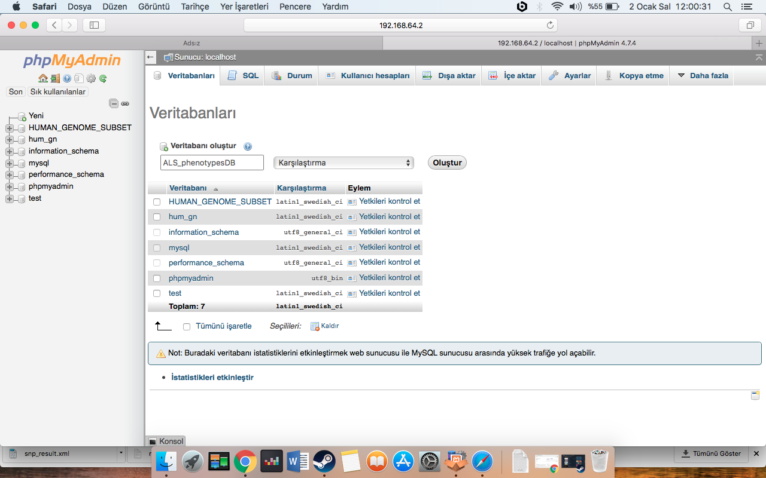

Slide 11
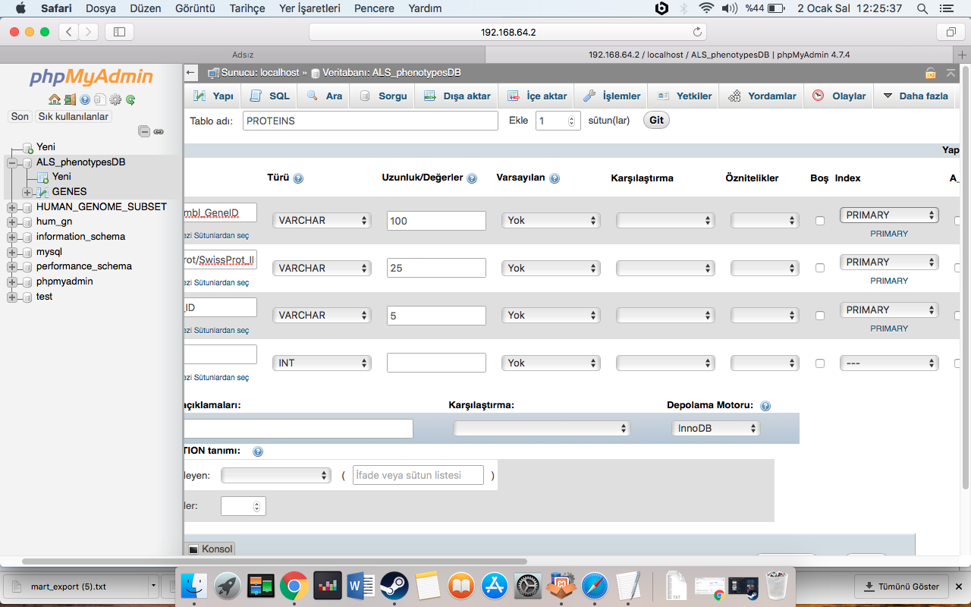
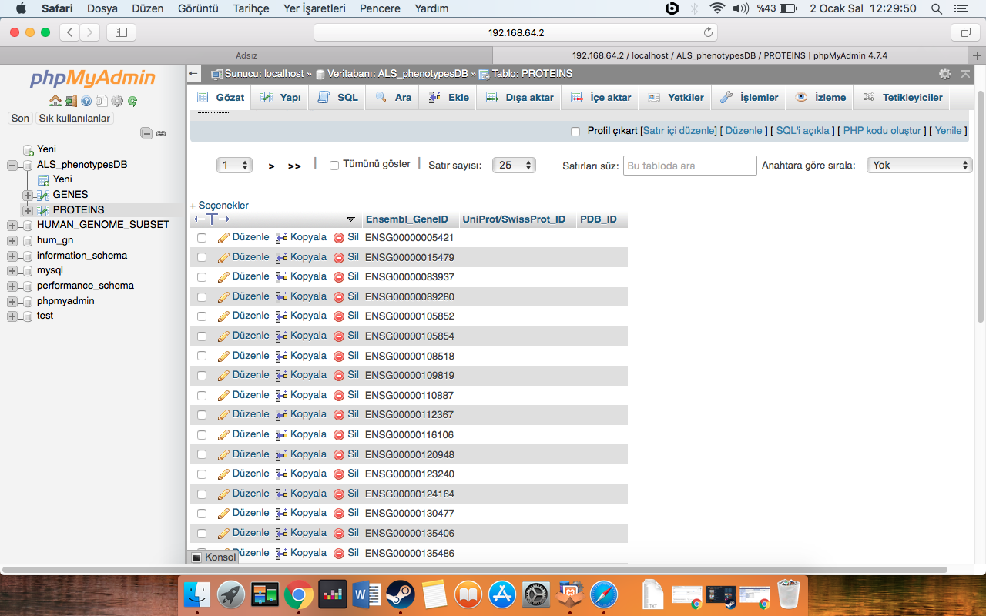

Slide 12
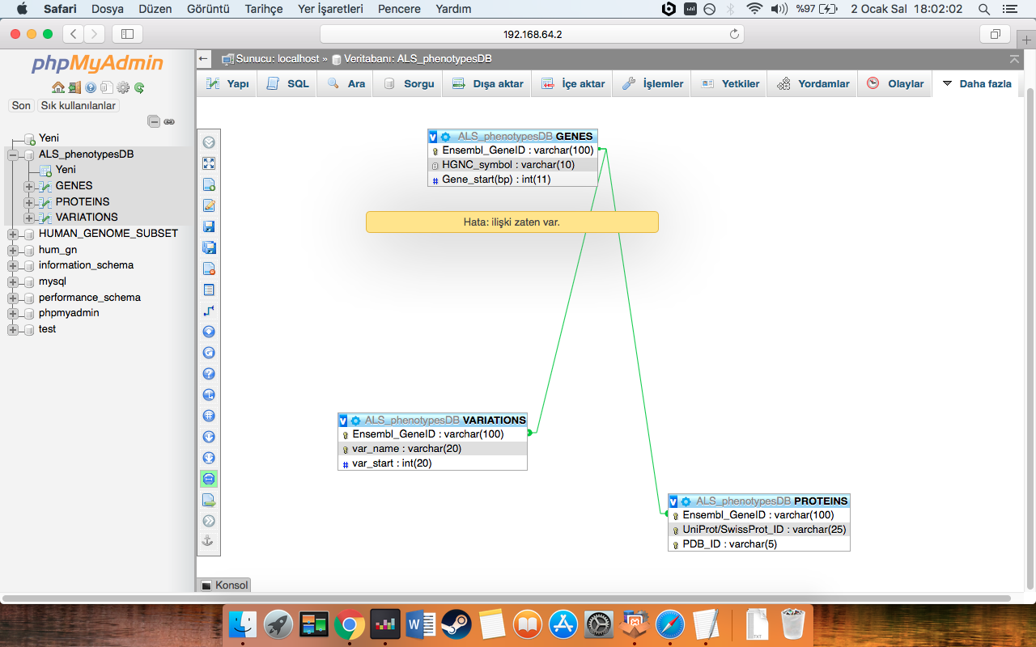

Slide 13
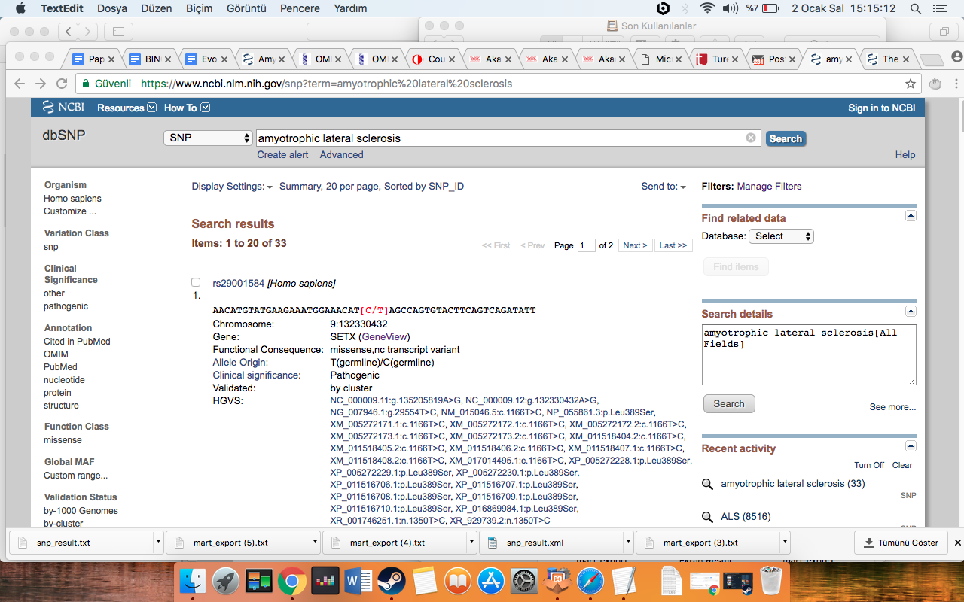

Slide 14
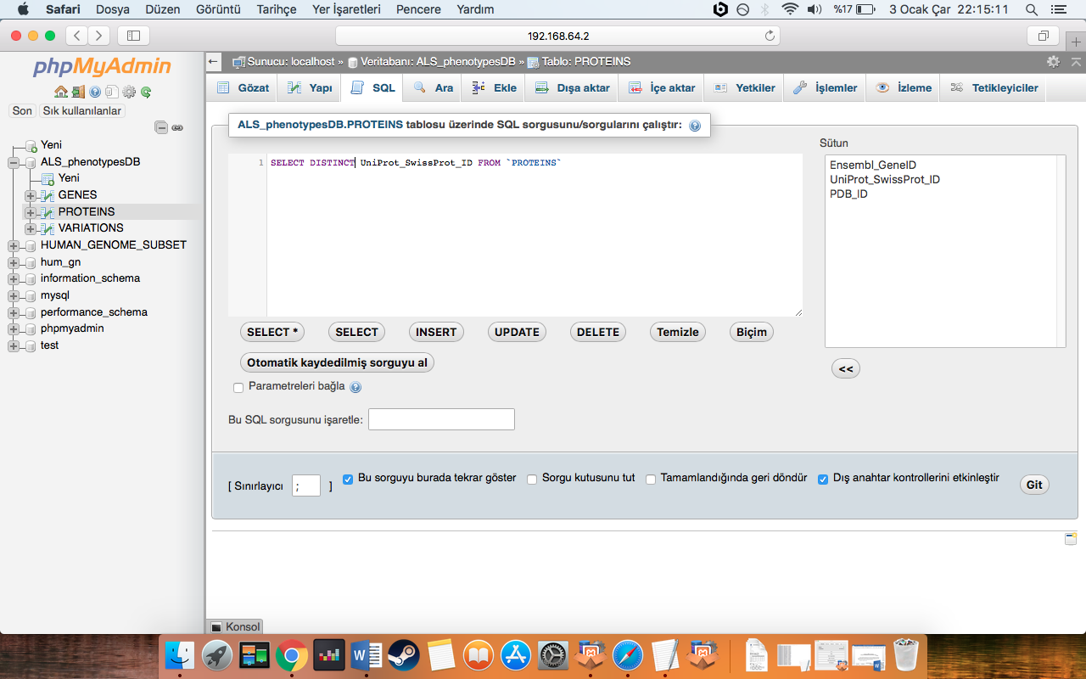
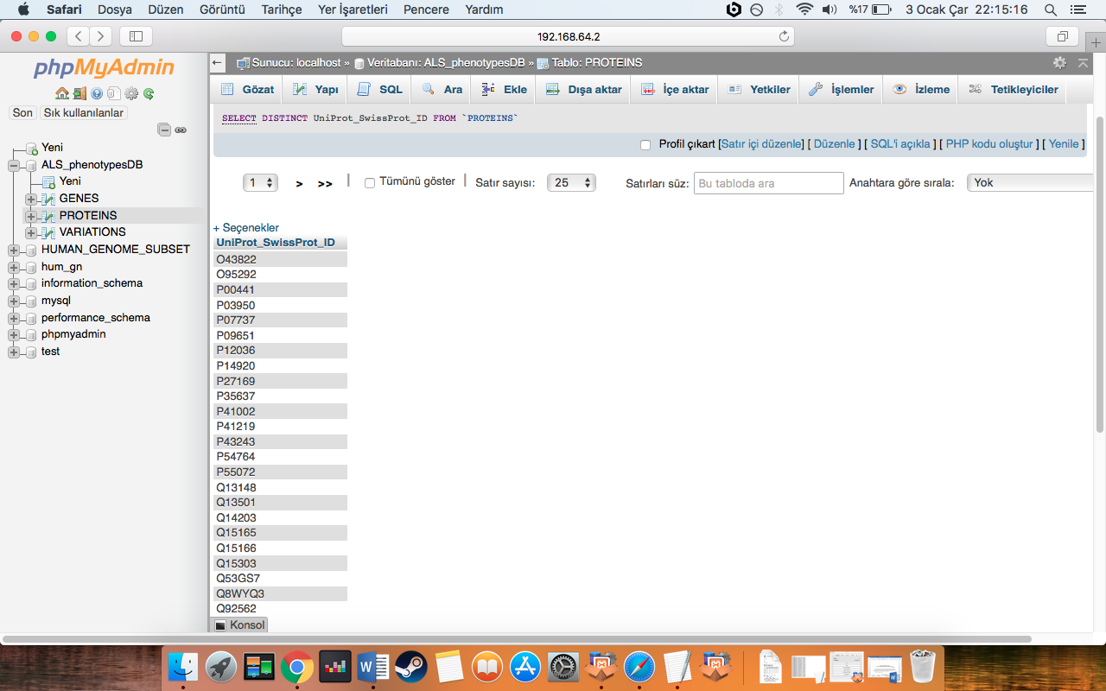

Slide 15
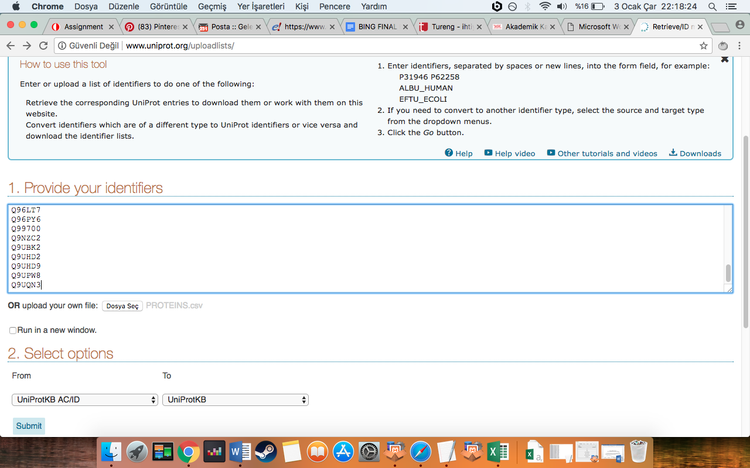
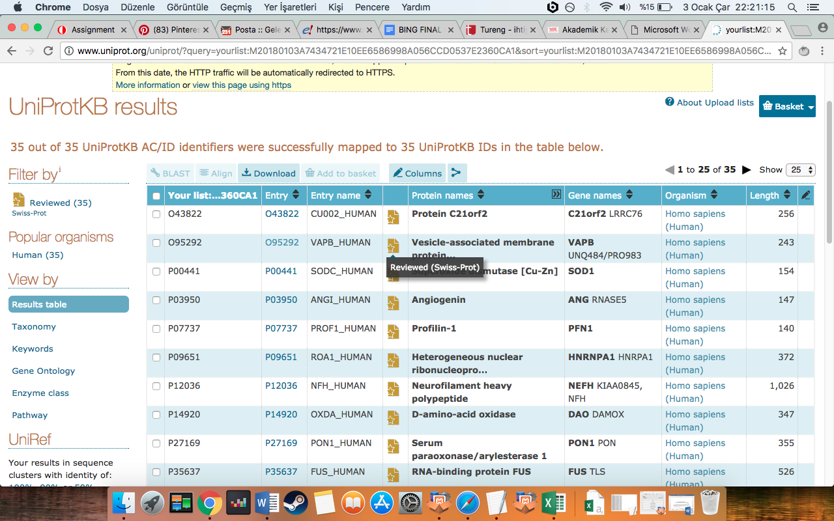

Slide 16
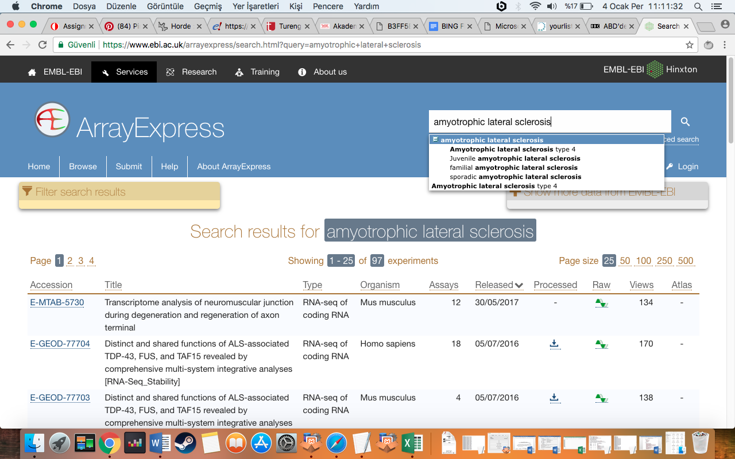
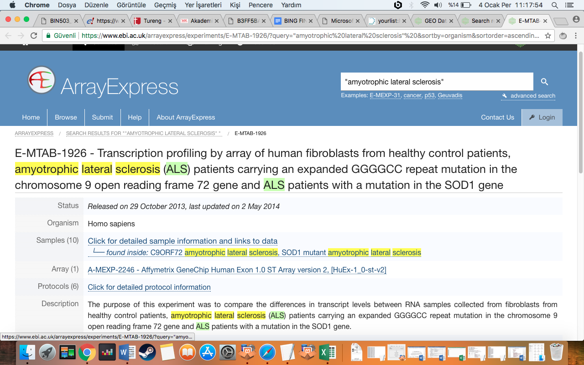
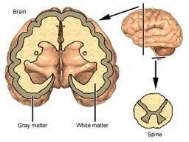

Slide 17
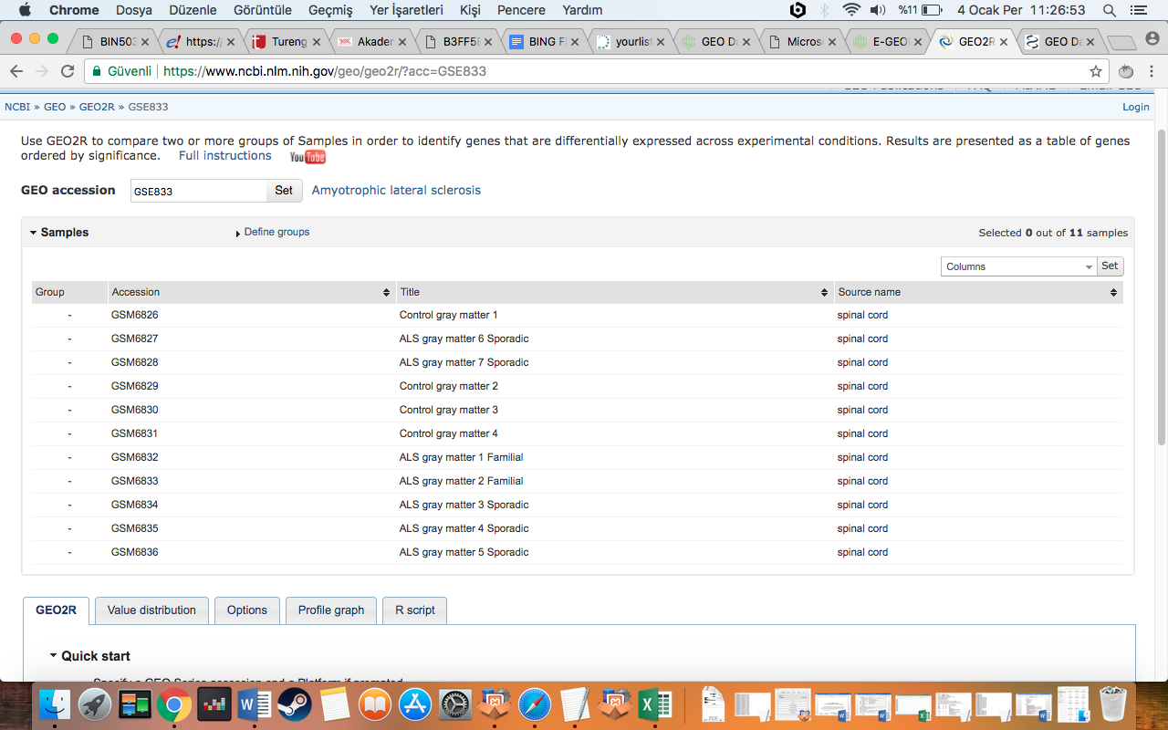
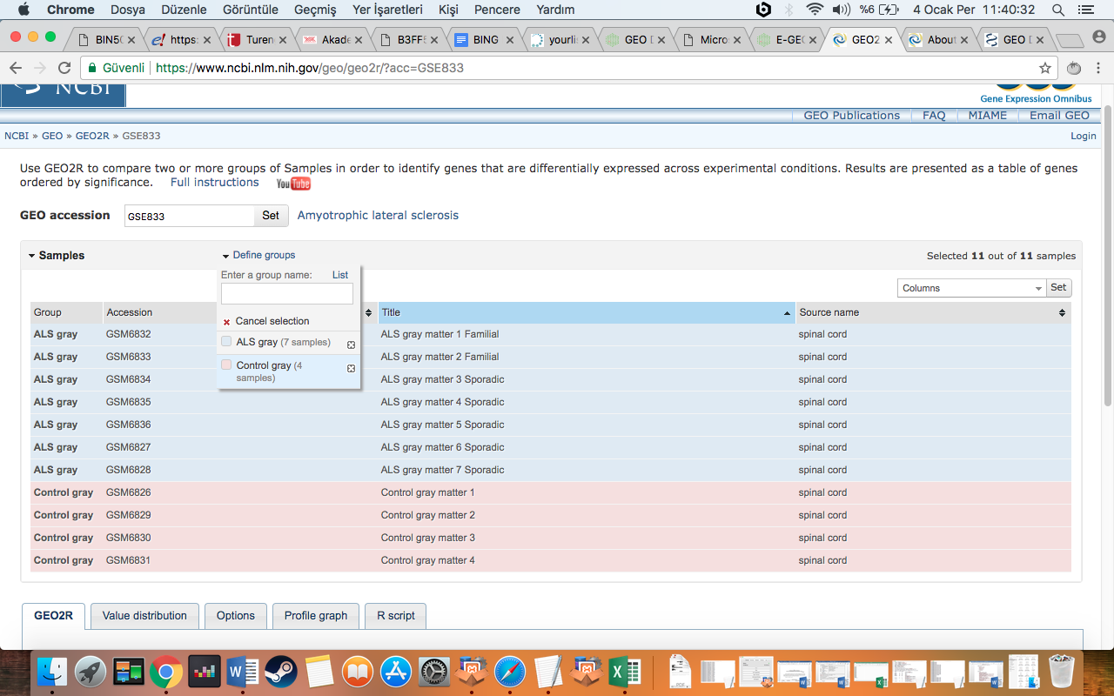
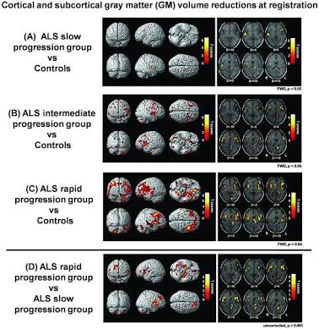

Slide 18
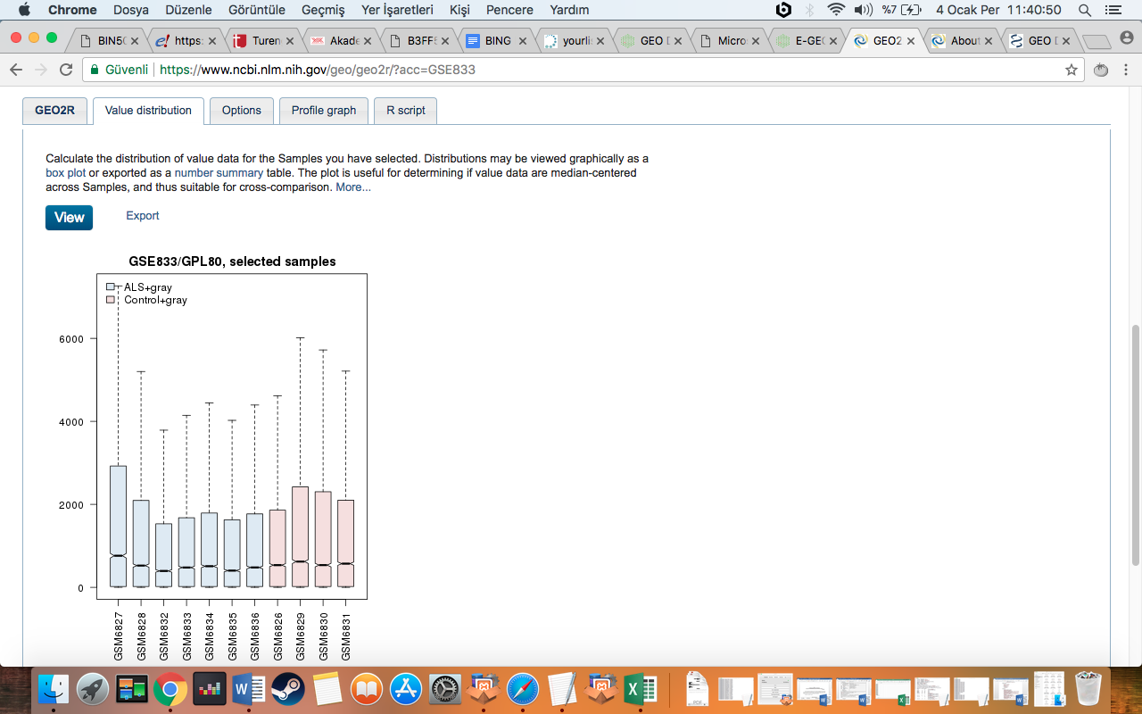
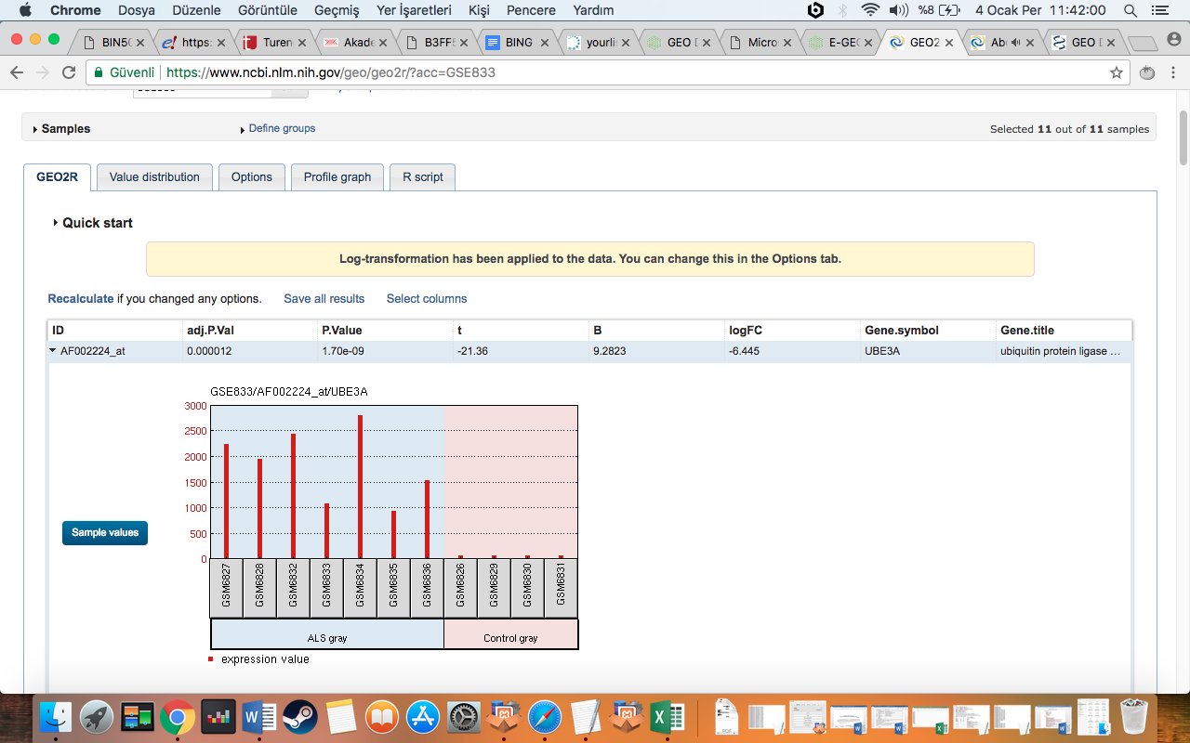

Slide 19
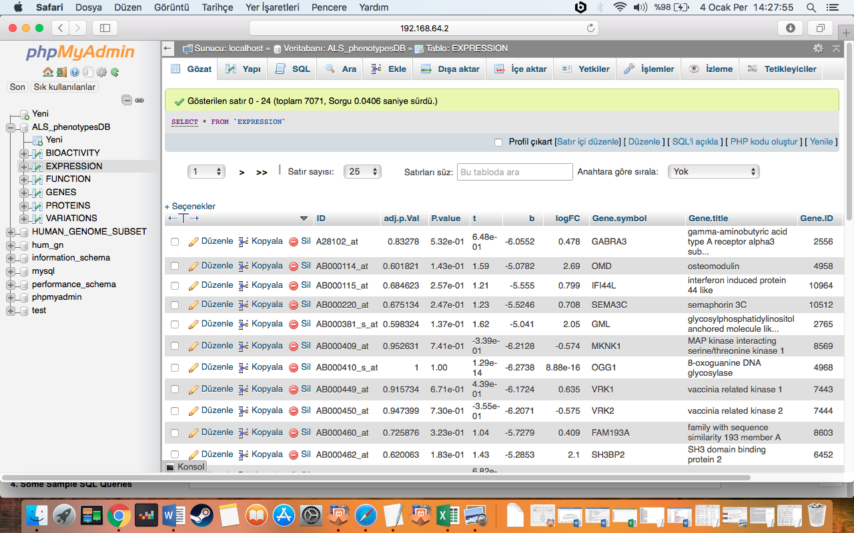

Slide 20
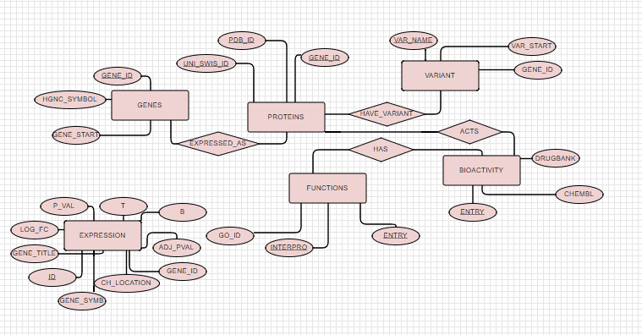

Slide 21
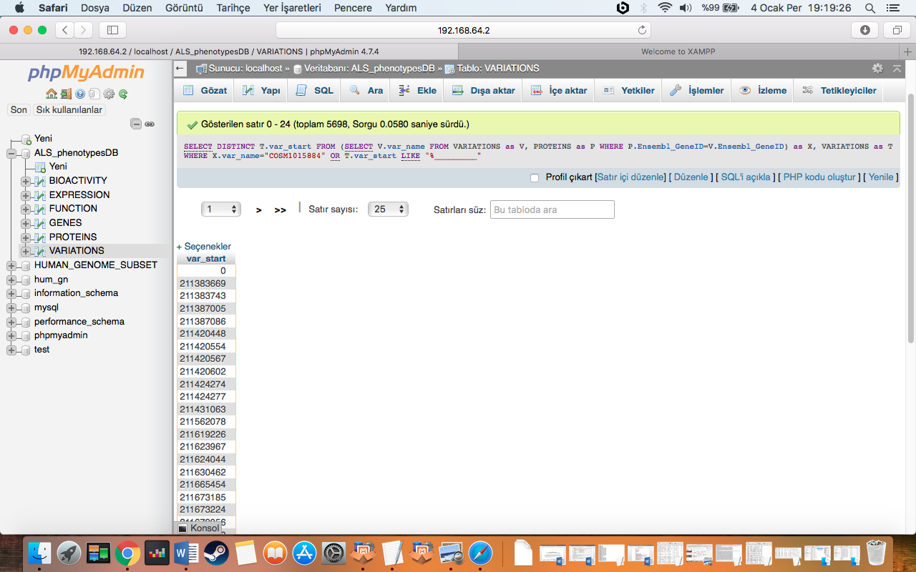
Example query
To find variation start positions which have 9 digits or variation name is COSM1015884:
SELECT DISTINCT T.var_start FROM (SELECT V.var_name FROM VARIATIONS as V, PROTEINS as P WHERE P.Ensembl_GeneID=V.Ensembl_GeneID) as X, VARIATIONS as T WHERE X.var_name="COSM1015884" OR T.var_start LIKE "%_________"

Slide 22
-People who show ALS phenotypes have different expression pathways and different kinds of protein product variations comparing to people who do not have ALS phenotypes. (As can be se7en in VARIATIONS table content)
-the disease have been widely studied. (There are lots of entries about the disease in biological dbs, like Ensembl, chEMBL, DrugBank,etc.) Also as can be seen in GEO2R analysis, there are lots of statistical analysis for the studies,too.
-In all biological database analysis for phenotypes of ALS, there could be seen that there are lots of alterations, changes in gene expression or protein productions, signalling pathways or growing pathways, and go on.
-mutations in genes causes the un-functional or re-functional proteins. As can be seen in the GENE table, there are lots of different genes which are related to the development of the ALS phenotypes. And any functional changes in these genes can cause ALS or ALS-related disease phenotypes

